Slide 1


Container orchestration
using Kubernetes

Slide 2



Course : Mastering DevOps
Lecture On : Container Orchestration using Kubernetes
Instructor: Dipesh Garg

Slide 3
Recap – Container Orchestration

Slide 4
MANAGING CONTAINERS
Challenges for managing containers:
Scalability
Avoiding port conflicts
Multi node
Availability
Deployments
Logging and monitoring

Slide 5
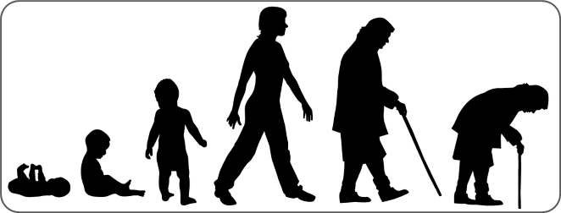
CONTAINER ORCHESTRATION
Container orchestration is all about managing the life cycle of containers.
It helps with managing large, dynamic environments.

Slide 6
LIFE CYCLE OF A CONTAINER
The life cycle of a container includes three phases:
Starting phase: Configuration phase - container name, image name, port mapping, volume and network configuration
Running phase: Scaling, load balancing, availability and health check
Deletion phase: Clean-up of the resources associated with a container

Slide 7
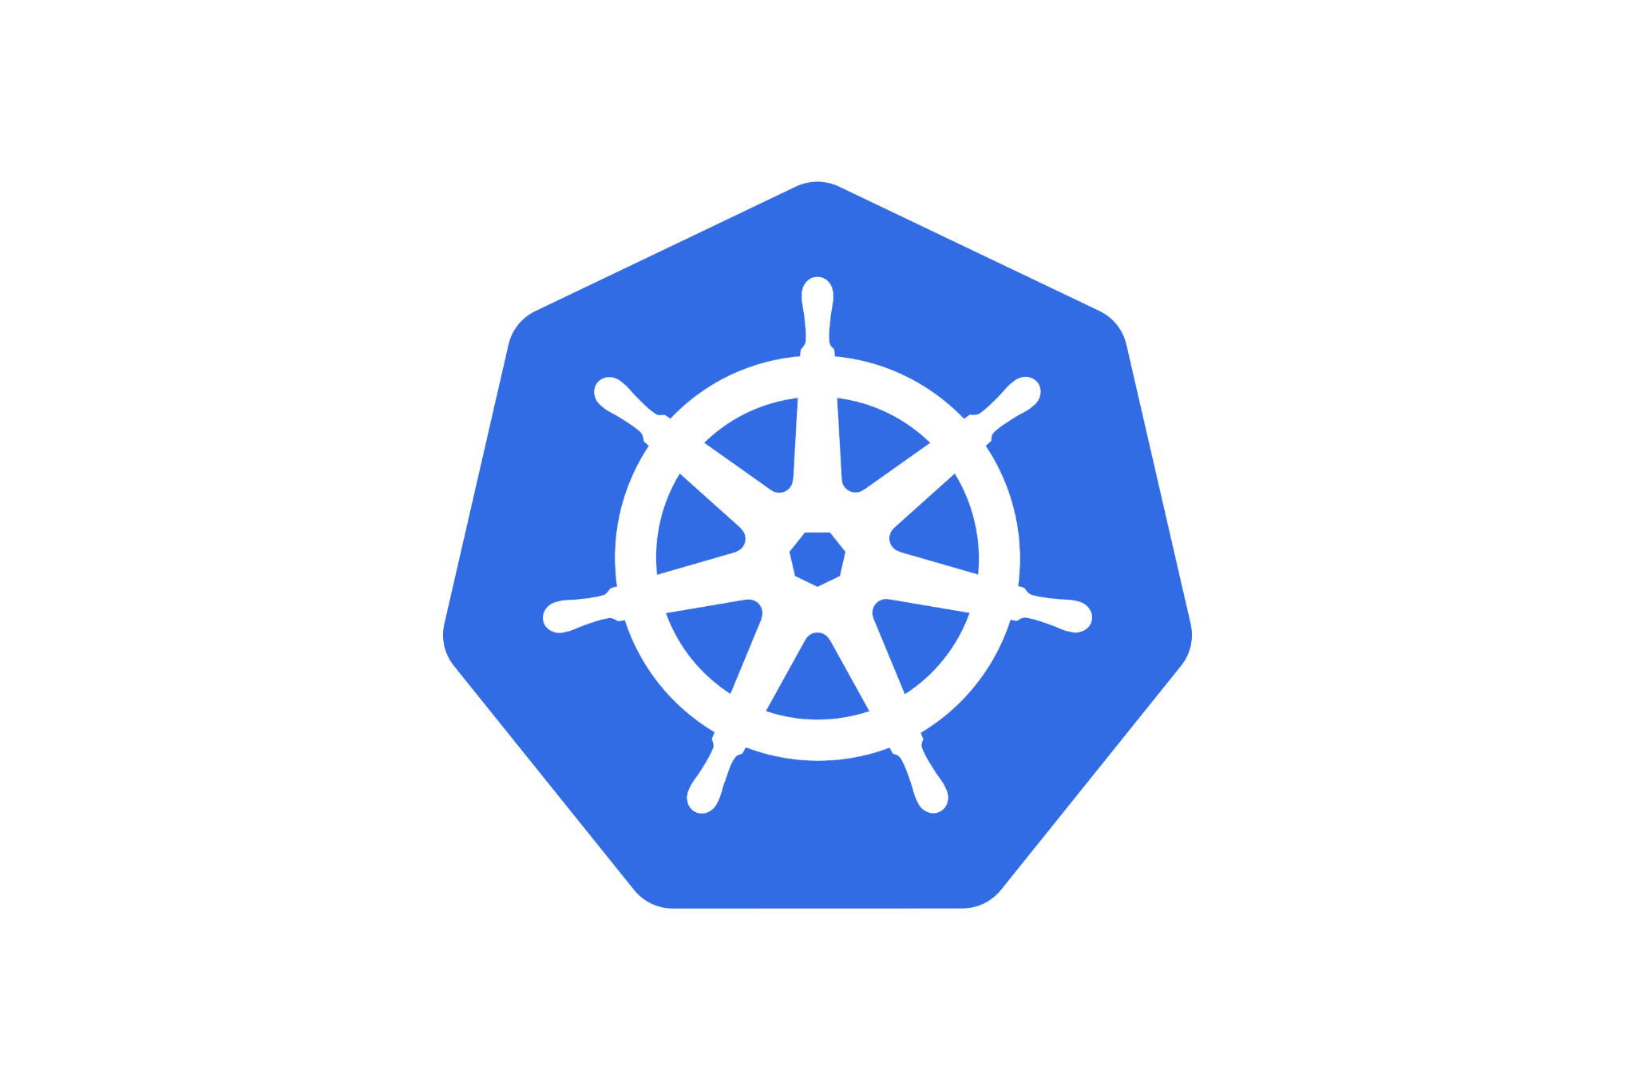
Kubernetes

Slide 8

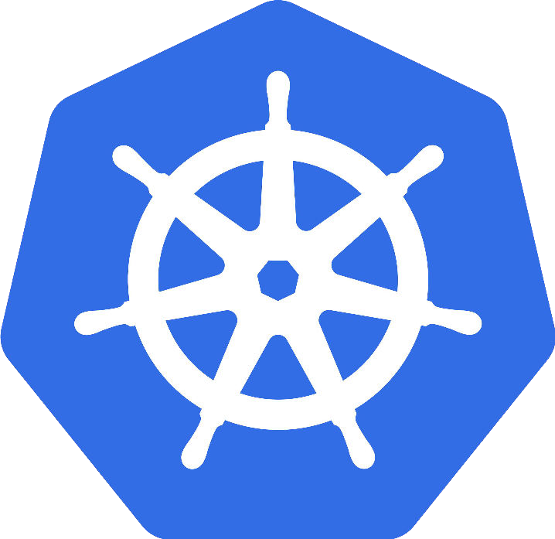
KUBERNETES
Monolithic Application
Transition to Microservices
Docker
Kubernetes
Recruitment website
Recruitment website
Create containers for your application
Launch your containerised application in K8s
Job applicants
Recruiters
Job vacancies
Job applicants
Recruiters
Job vacancies

Slide 9
MEET KUBERNETES
Open source and portable platform
A container
orchestration
tool
Automates scaling of workloads
Written in the ‘Go’ programming language
Groups containers into logical units
Google’s Brainchild. Now, donated to CNCG

Slide 10
WHAT DOES KUBERNETES DO?
System for running and coordinating containerized applications across a cluster of machines.
Manage the life cycle of containerized applications.
It manages the services using methods that provide predictability, scalability and high availability.
It easily coordinates the deployments of your system:
  Which containers need to be deployed
  Where should the containers be deployed

Slide 11
ADVANTAGES
Service discovery and load balancing
Storage orchestration
Automated rollouts and rollbacks
Automatic bin packing
Self-healing
Secret and configuration management

Slide 12
KUBERNETES ARCHITECTURE
Follows a client-server architecture.
At a very high level,
From a high level, a Kubernetes environment consists of
  control plane (master)
  Distributed storage system for keeping the cluster state consistent (etcd)
  Several cluster nodes (Kubelets)
The various components present in the master server are a kube-apiserver, an etcd storage, a kube-controller-manager, a cloud-controller-manager, a kube-scheduler and a DNS server Kubernetes services.

Slide 13
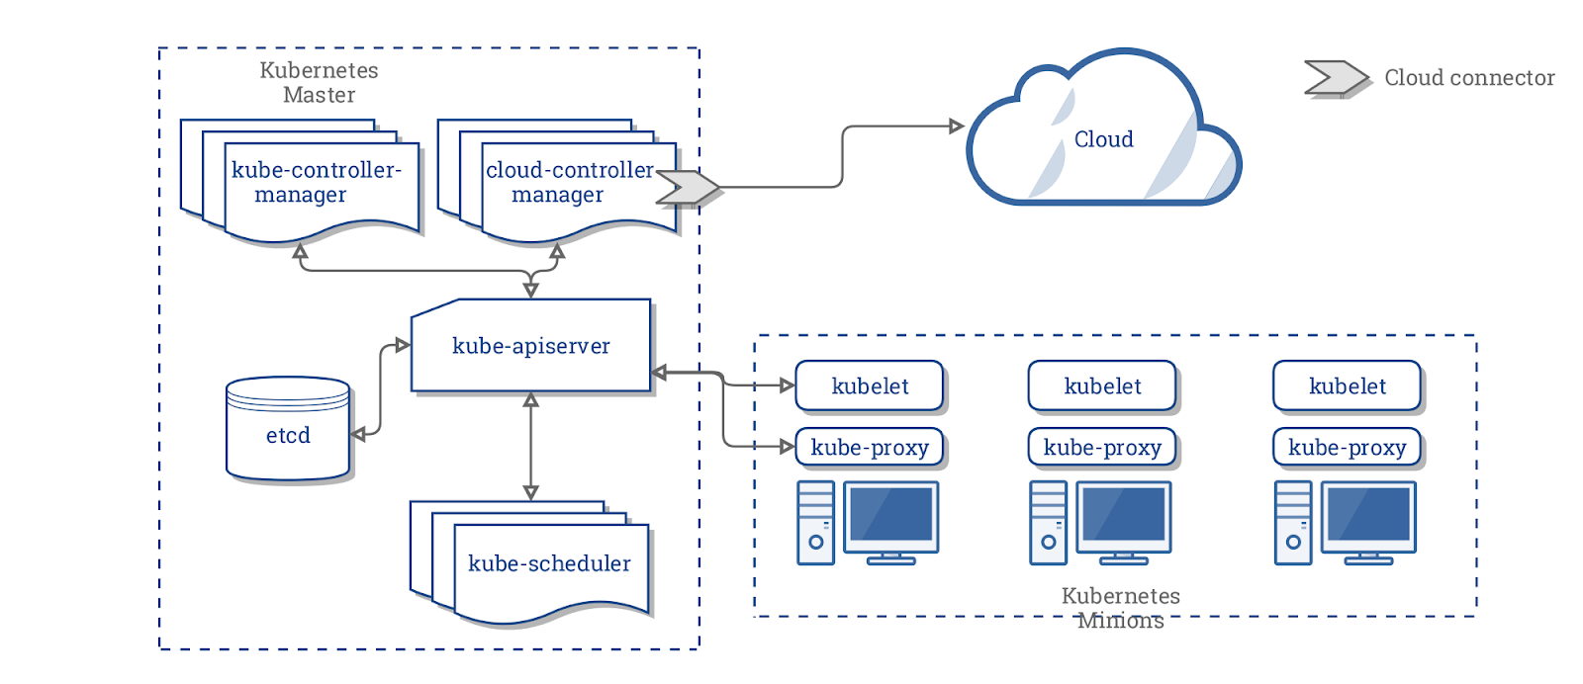
ARCHITECTURE

Slide 14
ARCHITECTURE: MASTER COMPONENTS
etcd cluster: It is a simple, distributed key value storage which is used to store the Kubernetes cluster data, API objects and service discovery details.
kube-apiserver: It is the central management entity that receives all REST requests for modifications serving as frontend to the cluster.
Kube-controller-manager: It runs different controller processes in the background to perform routine tasks and regulate the shared state of the cluster.
Cloud-controller-manager: It is responsible for managing controller processes with dependencies on the underlying cloud provider.
Kube-scheduler: It helps schedule the pods on the various nodes based on resource utilisation.

Slide 15
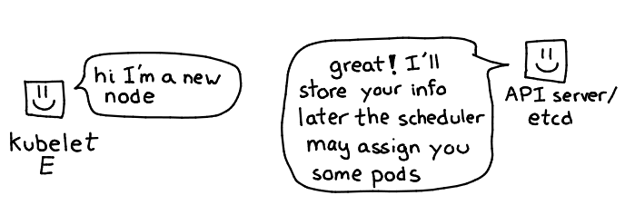
ARCHITECTURE: NODE COMPONENTS
Kubelet: It is a service on the node that regularly takes in new or modified pod specifications and ensures that pods and their containers are healthy and running in the desired state.
Kube-proxy: It is a proxy service running on each worker node to deal with individual host subnetting and expose the services to the external world.

Slide 16
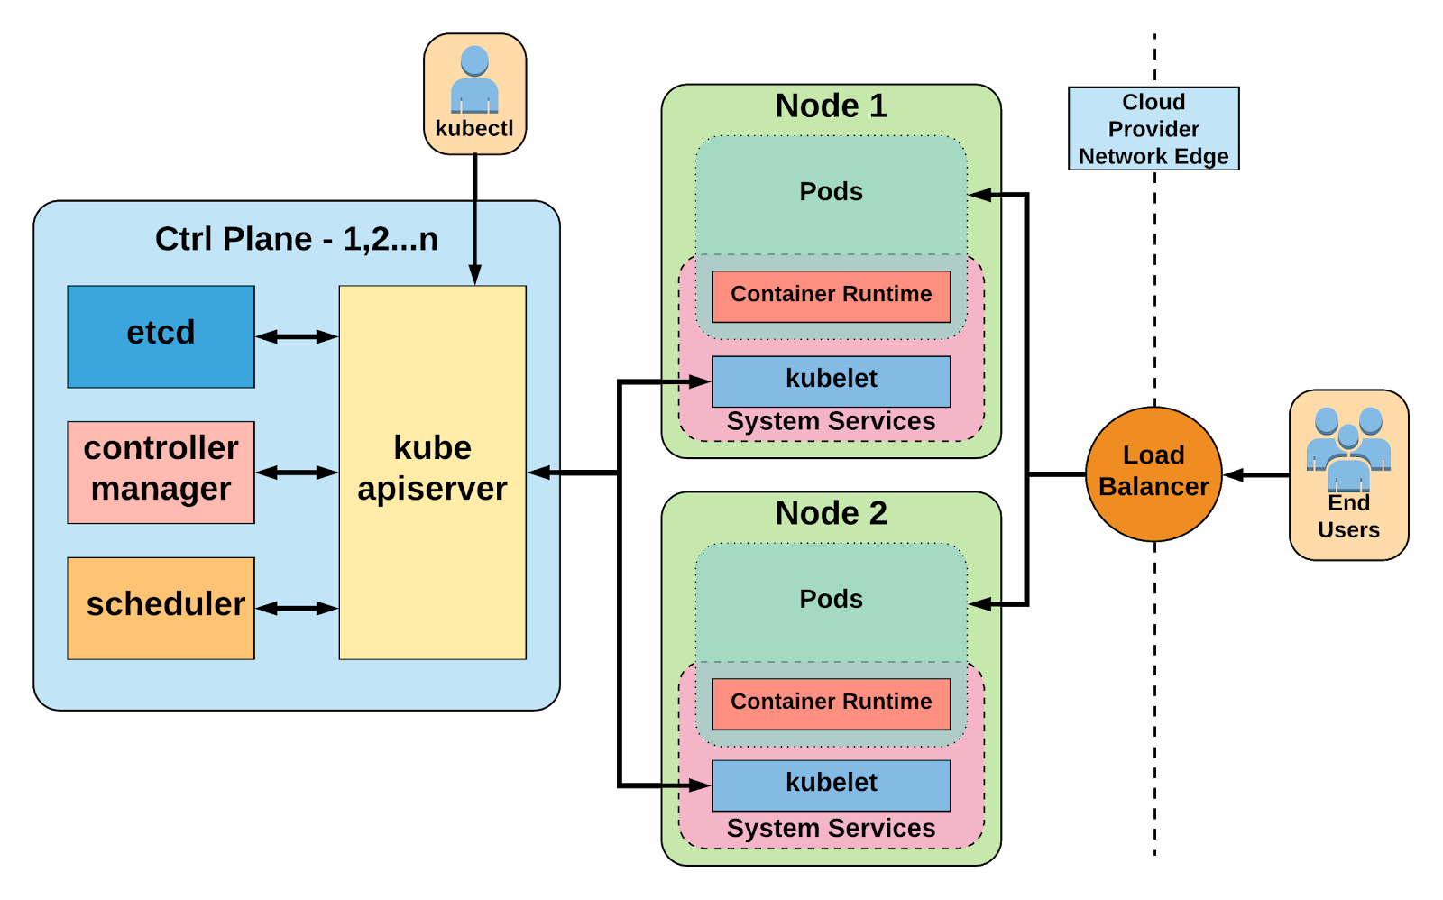
ARCHITECTURE: COMPLETE FLOW

Slide 17
Production Cluster Setup
Multiple master and worker nodes
Separate physical or virtual machines
Maintaining high availability of all control plane components

Slide 18

Production Cluster Setup
Test on local machine ?

Slide 19
MINIKUBE
Minikube is a local Kubernetes, focusing on making it easy to learn and develop for Kubernetes.
All you need is a Docker (or similarly compatible) container or a virtual machine (VM) environment, and Kubernetes is a single command away: minikube start.
It creates a single node cluster inside a VM.
This cluster allows you to demo Kubernetes operations without requiring the time and resource-consuming installation of full-blown K8s.
This flexibility enables you to easily try out the Kubernetes deployments, perform development tasks or test configurations.

Slide 20
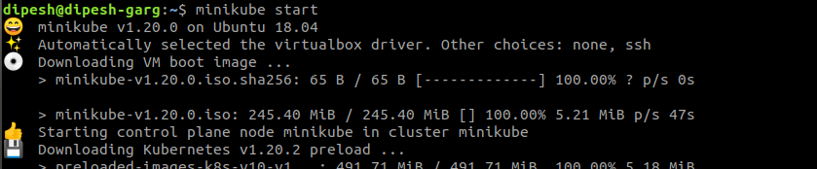
MINIKUBE USAGE
Installation:
  https://minikube.sigs.k8s.io/docs/start/
  curl -LO https://storage.googleapis.com/minikube/releases/latest/minikube-linux-amd64
  sudo install minikube-linux-amd64 /usr/local/bin/minikube
  minikube start
  minikube dashboard

Slide 21
Doubt Clearance Window

Slide 22
Tasks to Complete After Today’s Session
MCQs
Conceptual Questions
Project Checkpoint

Slide 23
Thank You!

